Slide 1
Jaringan Wireless Area Network (WLAN) IEEE 802.11
KTI [Tugas 3]
Soleh Elfrianto Hardiyono
PENS D4 LJ PJJ 2014
2110147044

Slide 2
WLAN IEEE802.11 adalah …
Serangkaian spesifikasi kendali akses medium dan lapisan fisik untuk mengimplementasikan komunikasi komputer wireless local area network di frekuensi 2.4, 3.6, 5, dan 60 GHz. Mereka diciptakan dan dioperasikan oleh Institute of Electrical and Electronics Engineers. Versi dasar dirilis tahun 1997 dan telah melalui serangkaian pembaruan dan menyediakan dasar bagi produk jaringan nirkabel Wi-Fi.

Slide 3
Perbedaan LAN dan WLAN
WLAN memakai gelombang radio sebagai physical layer-nya.
WLAN menggunakan MAC CSMA/CA (Carrier Sense Multiple Access Collision Avoidance) sedangkan LAN menggunakan CSMA/CD (Carrier Sense Multiple Access Collision Detection).
WLAN mendukung pengguna yang bersifat mobile, sedangkan LAN tidak

Slide 4
Kode tertentu untuk standarisasi dalam teknologi komunikasi WLAN IEE 802.11 :
802.1: LAN/MAN Management and Media Access Control Bridges
802.2: Logical Link Control (LLC)
802.3: CSMA/CD (Standar untuk Ehernet Coaxial atau UTP)
802.4: Token Bus
802.5: Token Ring (bisa menggunakan kabel STP)
802.6: Distributed Queue Dual Bus (DQDB) MAN
802.7: Broadband LAN
802.8: Fiber Optic LAN & MAN (Standar FDDI)
802.9: Integrated Services LAN Interface (standar ISDN)

Slide 5
Cont’..
802.10: LAN/MAN Security (untuk VPN)
802.11: Wireless LAN (Wi-Fi)
802.12: Demand Priority Access Method
802.15: Wireless PAN (Personal Area Network) > IrDA dan Bluetooth
802.16: Broadband Wireless Access (standar untuk WiMAX)

Slide 6
Standarisasi IEEE 802.11a
Standard IEEE 802.11a bekerja pada frekuensi 5GHz mengikuti standard dari UNII (Unlicensed National Information Infrastructure). Teknologi IEEE 802.11a tidak menggunakan teknologi spread-spectrum melainkan menggunakan standar frequency division multiplexing (FDM). Mampu mentransfer data hingga 54 Mbps

Slide 7
Standarisasi IEEE 802.11b
Standar 802.11b saat ini yang paling banyak digunakan satu. Menawarkan thoroughput maksimum dari 11 Mbps (6 Mbps dalam praktek) dan jangkauan hingga 300 meter di lingkungan terbuka. Ia menggunakan rentang frekuensi 2,4 GHz, dengan 3 saluran radio yang tersedia. Transmisi data 5,4 hingga 11 Mbps

Slide 8
Standarisasi IEEE 802.11c
Standar 802.11c (disebut WiFi), yang menjembatani standar 802.11c tidak menarik bagi masyarakat umum. Hanya merupakan versi diubah 802.1d standar yang memungkinkan 802.1d jembatan dengan 802.11-perangkat yang kompatibel (pada tingkat data link).

Slide 9
Standarisasi IEEE 802.11e
Standar 802.11e yang dimaksudkan untuk meningkatkan kualitas layanan pada tingkat data link layer. Tujuan standar ini adalah untuk menentukan persyaratan paket yang berbeda dalam hal bandwidth dan keterlambatan transmisi sehingga memungkinkan transmisi yang lebih baik suara dan video.

Slide 10
Standarisasi IEEE 802.11f
Standar 802.11f adalah rekomendasi untuk jalur akses vendor produk yang memungkinkan untuk menjadi lebih kompatibel. Ia menggunakan Inter-Access Point Protocol Roaming, yang memungkinkan pengguna roaming transparan akses beralih dari satu titik ke titik lain sambil bergerak, tidak peduli apa merek jalur akses yang digunakan pada infrastruktur jaringan. Kemampuan ini juga hanya disebut roaming.

Slide 11
Standarisasi IEEE 802.11g
Standar 802.11g menawarkan bandwidth yang tinggi (54 Mbps throughput maksimum, 30 Mbps dalam praktek) pada rentang frekuensi 2,4 GHz. Standar 802.11g mundur-kompatibel dengan standar 802.11b, yang berarti bahwa perangkat yang mendukung standar 802.11g juga dapat bekerja dengan 802.11b.

Slide 12
perangkat WLAN yang dapat digunakan pada tipe yang berbeda dalam struktur jaringan :
Station
Access Point
Wireless Routers
Wireless bridges

Slide 13
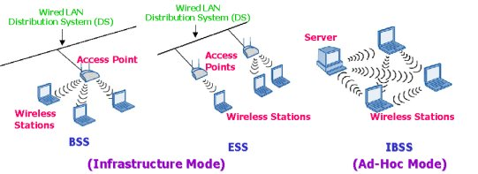
infraStruktur WLAN

Slide 14
WLAN Station
Menggunakan standar 802.11 pada MAC dan physical layer untuk mendukung komunikasi nirkabel, contoh :
notebook,
komputer meja (PC),
peralatan yang menggunakan access point, bridge dan router

Slide 15
IEEE 802.11 Physical Layer: Spread Spectrum
Frequency Hopping Spread Spectrum (FHSS)
The FHSS physical layer has 22 hop patterns to choose from. The frequency hop physical layer is required to hop across the 2.4GHz ISM band covering 79 channels. Each channel occupies 1Mhz of bandwidth and must hop at the minimum rate specified by the regulatory bodies of the intended country. A minimum hop rate of 2.5 hops per second is specified for the United States.
Direct Sequence Spread Spectrum (DSSS)
The DSSS physical layer uses an 11-bit Barker Sequence to spread the data before it is transmitted. Each bit transmitted is modulated by the 11-bit sequence. This process spreads the RF energy across a wider bandwidth than would be required to transmit the raw data. The processing gain of the system is defined as 10x the log of the ratio of spreading rate (also know as the chip rate) to the data. The receiver despreads the RF input to recover the original data.

Slide 16
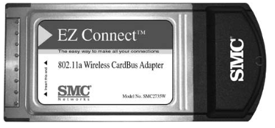
NIC (Network Interface Card)
Kemampuan WLAN pada PC dan notebook yaitu menggunakan NIC dan driver. NIC didesain supaya dapat digunakan pada laptop atau notebook yang memiliki slot PCI card
Kartu Adapter Nirkabel SMC Networks 802.11a.

Slide 17
IEEE 802.11 Physical Layer： Frame format
Immediate
Sender (AP3)
Intermediate
Destination
(AP1)
Ultimate
Destination (E)
Source
(A)
Control
Duration
Addr1
Addr2
Addr3
Control
Addr4
Data
CRC
Distribution System
Frame Type (RTS,CTS,…)
ToDS
FromDS
A
E
RTS: Request-to-Send
CTS: Clear-to-Send
AP1
F
AP3
C
AP2
D
B
40

Slide 18
IEEE 802.11 Physical Layer： Frame format (con’t)
Frame control | Duration /ID | Addressing 1 | Addressing 2 | Addressing 3 | Sequence control | Addressing 4 | Frame body | CRC
Header：30Bytes including control
information、addressing、sequence
number、duration
Data ：0~2312Bytes,changing with frame
type
Error control：4Bytes,with CRC32
41

Slide 19
IEEE 802.11 Frame format (con’t)
Frame control | Duration /ID | Addressing 1 | Addressing 2 | Addressing 3 | Sequence control | Addressing 4 | Frame body | CRC
Protocol version | Type | Subtype | To DS | From DS | More flag | Retry | Pwr mgt | More Data | WEP | Order
42

Slide 20
MAC Layer：CSMA/CA
802.11 Collision Resolution
CSMA/CA
Hidden Terminal effect
How it works?
Carrier Sense Multiple Access/Collision Avoidance
43

Slide 21
802.11 Collision Resolution
Two senders might send RTS at the same time
Collision will occur corrupting the data
No CTS will follow
Senders will time-out waiting for CTS and retry with exponential backoff
RTS: Request-to-Send
CTS: Clear-to-Send
44

Slide 22
802.11 transmission Protocol
Sender A sends Request-to-Send (RTS)
Receiver B sends Clear-to-Send (CTS)
Nodes who hear CTS cannot transmit concurrently with A (red region)
Nodes who hear RTS but not CTS can transmit (green region)
Sender A sends data frame
Receiver B sends ACK
Nodes who hear the ACK can
now transmit
CTS
RTS
B
A
45

Slide 23
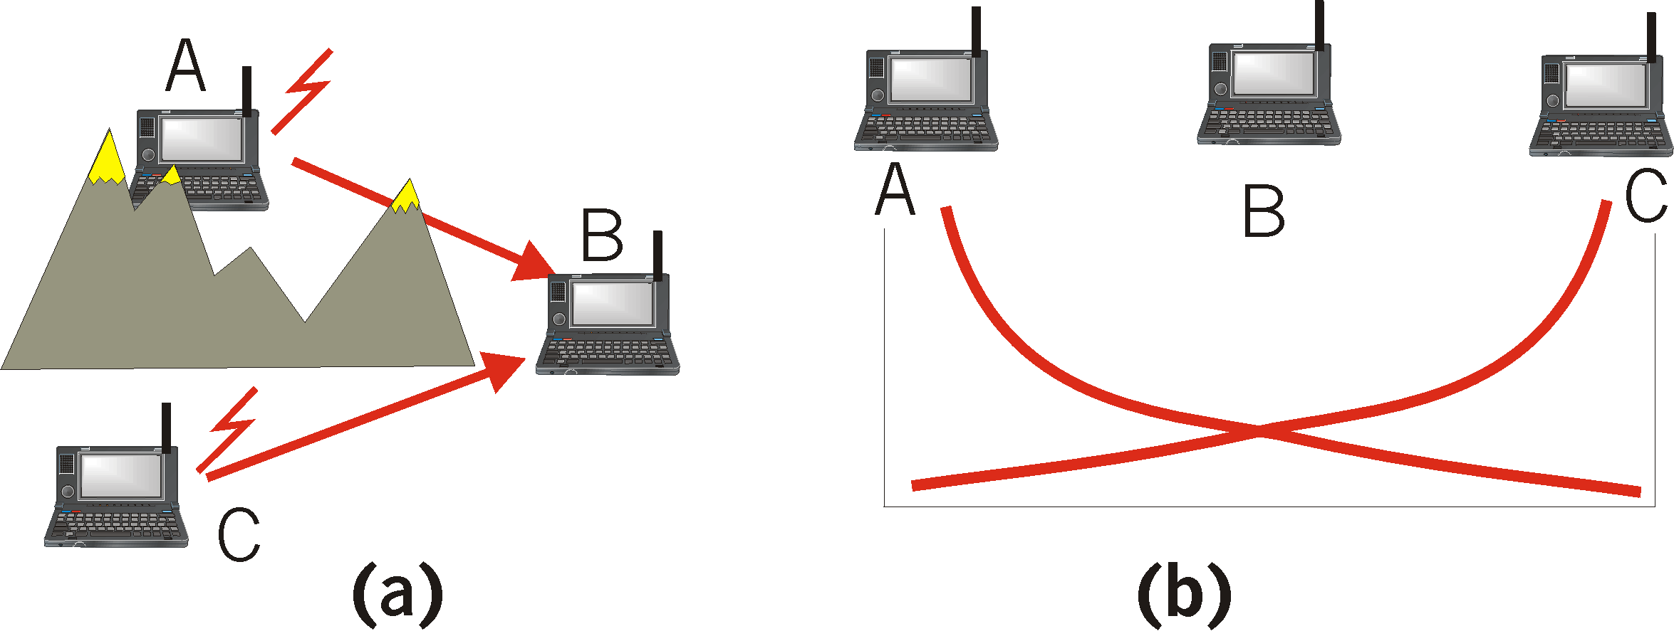
Hidden Terminal effect
(a) A and C cannot hear each other because of obstacles or signal attenuation; so, their packets collide at B
(b) goal: avoid collisions at B
CSMA/CA: CSMA with Collision Avoidance
46

Slide 24
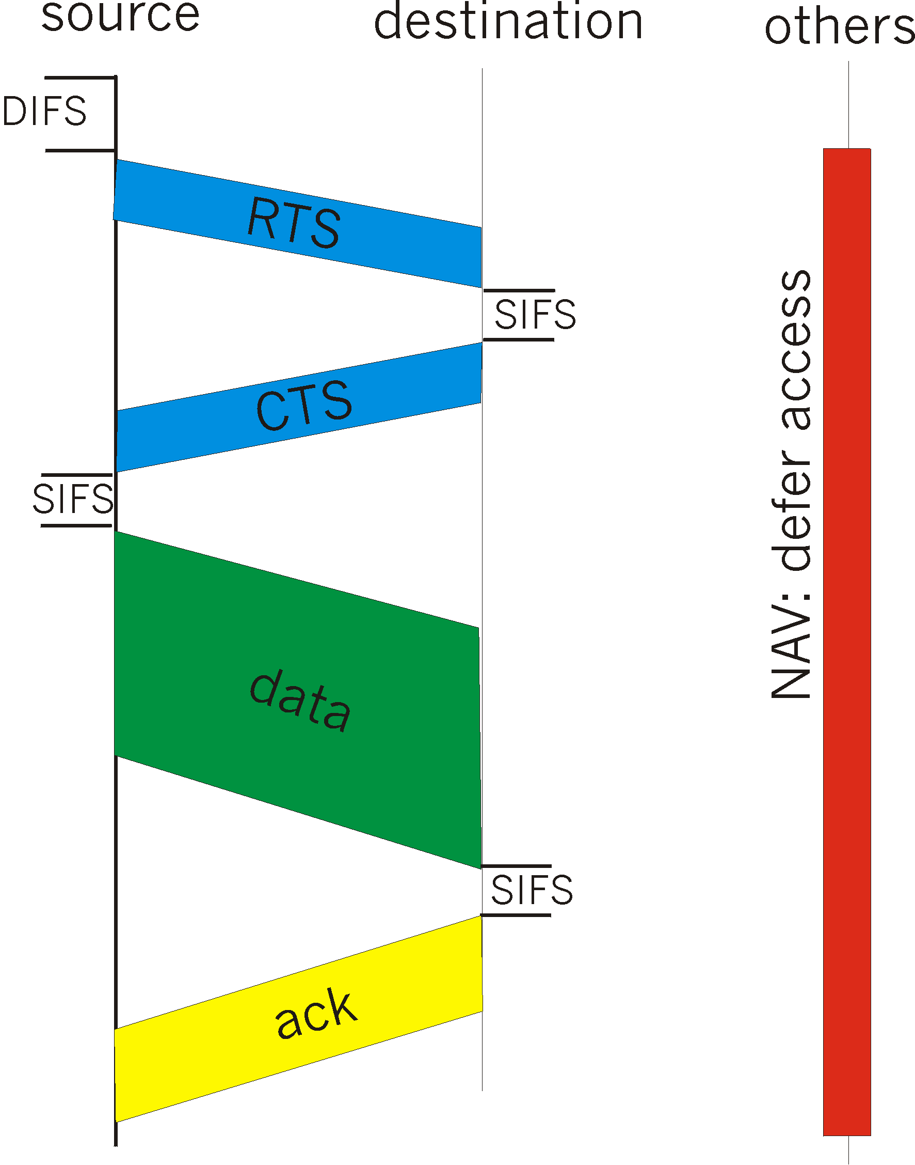
CSMA/CA (Collision Avoidance)
sense channel idle for DISF sec (Distributed Inter Frame Space), send RTS
receiver returns CTS after SIFS (Short Inter Frame Space)
CTS “freezes” stations within range of receiver (but possibly hidden from transmitter); this prevents collisions by hidden station during data
transmit data frame (no Collision Detection)
receiver returns ACK after SIFS (Short Inter Frame Space)
- if channel sensed busy then binary backoff
NAV: Network Allocation
Vector (min time of deferral)
(= min packet size in 802.3)
RTS and CTS are very short: collisions during data phase are thus very unlikely (the end result is similar to Collision Detection)
47

Slide 25
802.11b security features
ESSID
Network name, not encrypted
Rudimentary because the ESS ID is broadcast in beacon frames
Association
Capability to register a station with a WLAN
WEP (Wired Equivalent Privacy)
encrypts data using RC4 with 40 to 128-bit shared keys
Some vendors do in software, others in hardware
Symmetric Scheme – Same Key For Encrypt/Decrypt
Intended For:
Access Control (no WEP key, no access)
Privacy (encrypt data stream)
48

Slide 26
Wired Equivalent Privacy
Why Wired Equivalence Privacy?
Wireless medium has no packet boundaries
WEP control access to LAN via authentication
Wireless is an open medium
Provides link-level security equivalent to a closed medium (note: no end-to-end privacy)
Two Types of Authentication
Set on Client/Access Points (Same)
Open (Default): Clear-Text Authentication
No WEP key required for access
Shared-Key: Clear-Text Challenge (by AP)
Must respond with the correct WEP key, or no access
Broken due to bad use of the cipher [Walker, Berkeley Team, Arbaugh, Fluhrer]
49

Slide 27
WEP (cont.)
RSA “Fast-Packet Keying”
Fix Approved By IEEE Committee (2001)
Generates Unique Encryption Keys For Data Packets
Reduces Similarities Between Successive Packets
Temporal Key Integrity Protocol (TKIP)
Approved 2002/01/25, Optional 802.11 Standard
Helps Defeat Passive Packet Snooping
Dynamic Keys Defeat Capture of Passive Keys (WEP Hole)
Some Vendors Starting to Incorporate
50

Slide 28
Auth: Captive portal
Synopsis:
Intercepts first HTTP connection
Redirect to authentication page using SSL
Does access control based on login / password
Products
NoCatAuth (freeware)
Vernier Networks (commercial)
E-Passport, EZone
Costs:
Not intrusive nor expensive
51

Slide 29
Auth: 802.1X
Synopsis:
authentication before giving access to the network
Requires a PKI certificate on each client
Requires a central RADIUS server with EAP
Products:
CISCO Aironet 350 Series
Microsoft Windows XP
Costs:
Deployment is intrusive
Maintenance is expensive
Can be a corporate wide solution
52

Slide 30
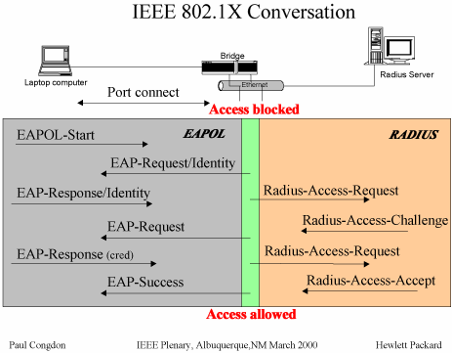
Extensible Authentication Protocol (EAP [RFC 2284])
A port begins in an unauthorized state, which allows EAP traffic only.
Once the Authenticator has received a Supplicant’s request to connect (an EAPOL-Start), the Authenticator replies with an EAP Request Identity message.
The returning Response Identity message is delivered to the Authentication Server.
53

Slide 31
#Tag
wikipedia
office
yahoo
Blue
google
wikipedia
excel
PowerPoint
chart
Workflow
Retro-style
windows
Images
word
Chart
Grey
graph
Metro ui
bing
Icons
Microsoft
business

